Slide 1

Data Development Utilizing Database Design and SQL
Chapter 2
Notes:
1

Slide 2
Introduction
Database design
Process of determining the particular tables and columns that will comprise a database.
Must understand database concepts first.
Process of normalization is the process in which you identify and fix potential problems in database design.

Slide 3
Relational Database
A collection of tables
Tables in TAL Distributors Database
Rep
Customer
Orders
Item
Order_Line

Slide 4
Entities, Attributes, and Relationships
Entity (like a noun)
An entity is like a noun, or object in OOP;
Examples: a person, place, thing or event
Attribute (like an adjective or adverb)
Property of an entity, similar to OOP.
Example of Person entity attributes:
Eye color
Birthdate
Relationship
Association between entities
Example: relationship between customer and sales rep.

Slide 5
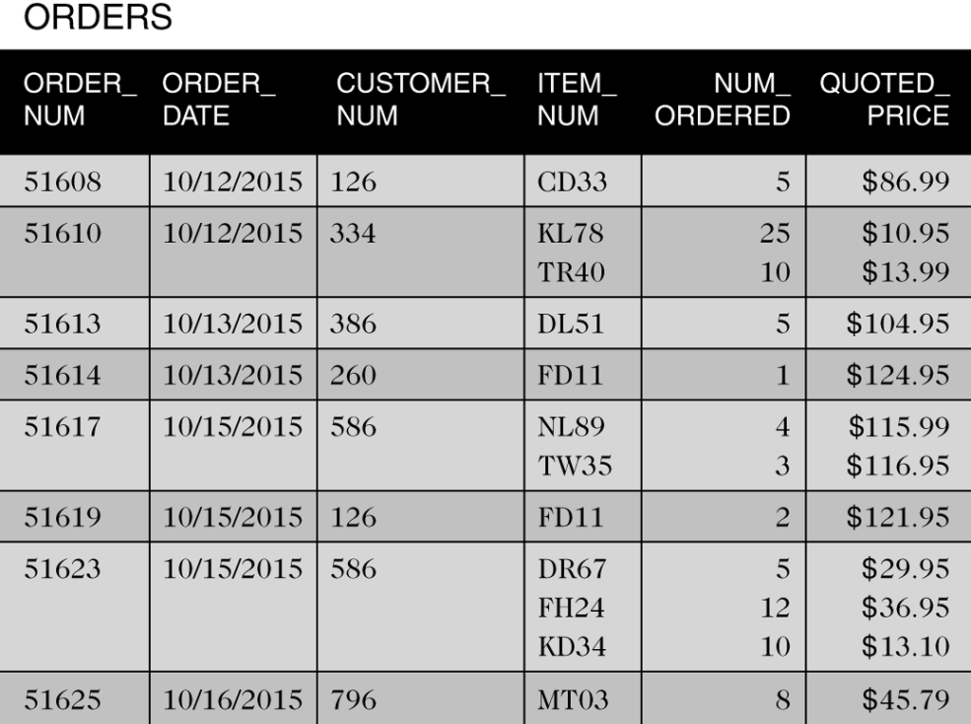
Entities, Attributes, and Relationships
One-to-many relationship
One rep is related to many customers
Implement by having a common column in two or more tables
REP_NUM is a column in the CUSTOMER table and the REP table
Repeating groups
Multiple entries in an individual location
Which columns have repeating groups in the ORDERS table on your right?

Slide 6
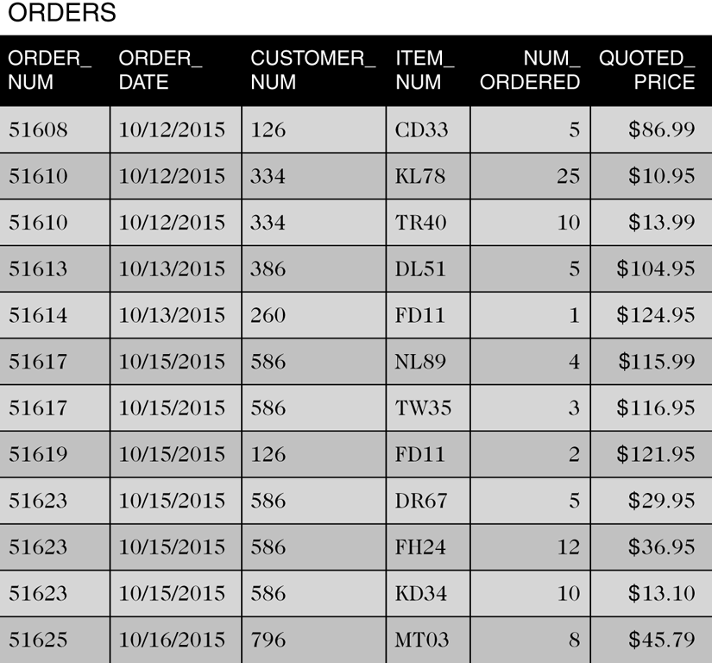
Entities, Attributes, and Relationships
What is different between this table design and the one on the previous slide?
Figure 2-3 ORDERS table without repeating groups

Slide 7
Entities, Attributes, and Relationships
Relation is a two-dimensional table
Entries in the table are single-valued
Each column has a distinct name
All values in a column are values of the same attribute
The order of the columns is immaterial
Each row is distinct
The order of the rows is immaterial

Slide 8
Entities, Attributes, and Relationships
Use shorthand representation to show tables and columns
REP (REP_NUM, LAST_NAME, FIRST_NAME, STREET,
CITY, STATE, POSTAL_CODE, COMMISSION, RATE)
CUSTOMER (CUSTOMER_NUM, CUSTOMER_NAME, STREET, CITY, STATE, POSTAL_CODE, BALANCE, CREDIT_LIMIT, REP_NUM)
ORDERS (ORDER_NUM, ORDER_DATE, CUSTOMER_NUM)
ORDER_LINE (ORDER_NUM, ITEM_NUM, NUM_ORDERED, QUOTED_PRICE)
ITEM (ITEM_NUM, DESCRIPTION, ON_HAND, CATEGORY, STOREHOUSE, PRICE)

Slide 9
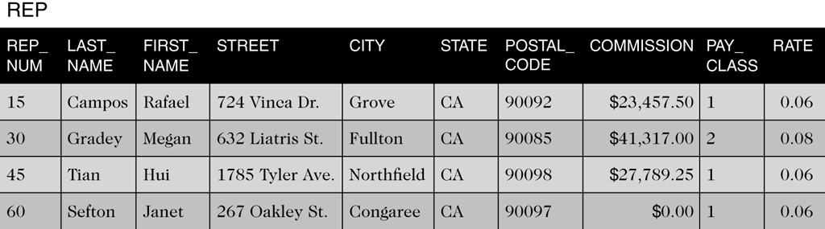
Functional Dependence
An attribute, B, is functionally dependent on another attribute (or collection), A, if a value for A determines a single value for B at any one time
B is functionally dependent on A
A functionally determines B
Example: REP.LAST_NAME is functionally dependent on REP.REP_NUM

Slide 10
Primary Keys
Unique identifier for a table
Column (attribute) A (or a collection of columns) is the primary key for a table (relation), R, if:
All columns in R are functionally dependent on A

Slide 11
Database Design Method
Read the requirements, identify the entities (objects) involved, and name the entities
Identify the unique identifiers for the entities identified in step 1
Identify the attributes for all the entities
Identify the functional dependencies that exist among the attributes
Use the functional dependencies to identify the tables by placing each attribute with the attribute or minimum combination of attributes on which it is functionally dependent
Identify any relationships between tables.

Slide 12
Database Design Requirements
For TAL Distributors
Must store data about sales reps, customers, items, orders, and order lines
Must enforce certain constraints; for example:
There is only customer per order
On a given order, there is at most one line item for a given item
The quoted price may differ from the actual price

Slide 13
Normalization
Identify the existence of potential problems
Provides a method for correcting problems
Goal
Convert unnormalized relations (tables that contain repeating groups) into various types of normal forms

Slide 14
Normalization
1 NF
Better than unnormalized
2 NF
Better than 1 NF
3 NF
Better than 2 NF

Slide 15
First Normal Form
A relation is in first normal form (1NF) if it does not contain any repeating groups
To convert an unnormalized relation to 1NF, expand the PK to include the PK of the repeating group
This effectively eliminates the repeating group from the relation

Slide 16
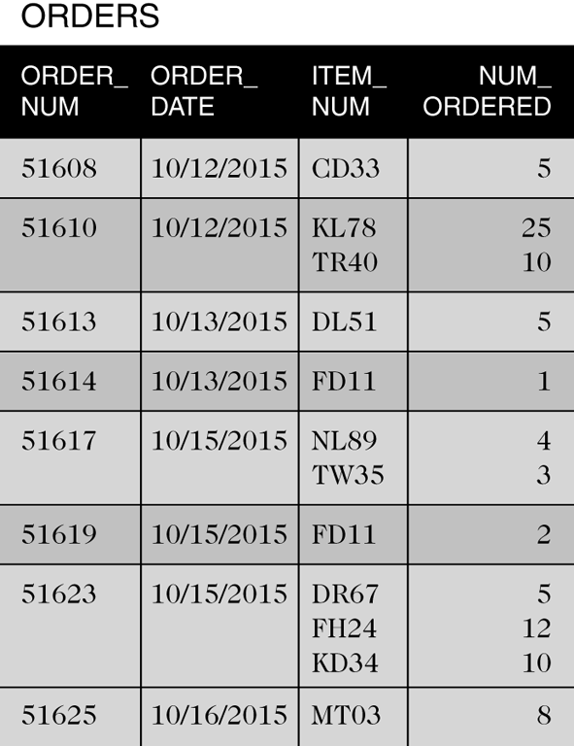
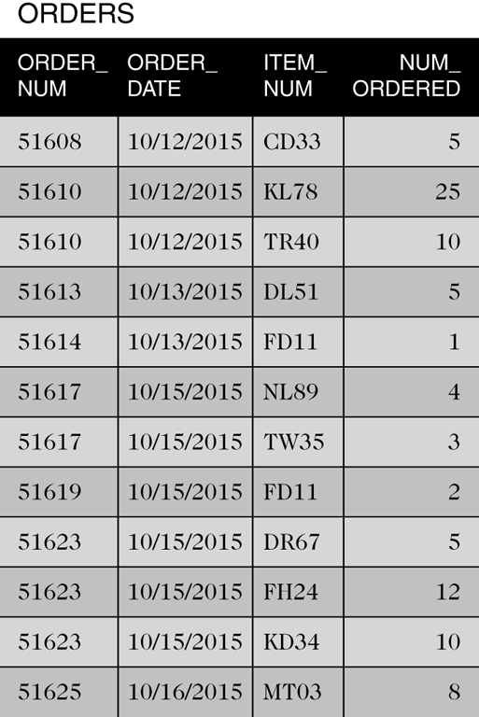
First Normal Form
Figure 2-7 Unnormalized order data
Figure 2-8 Order data converted to first normal form

Slide 17
Second Normal Form
Redundancy causes problems
Update Anomalies
Update
Inconsistent data
Additions
Deletions

Slide 18
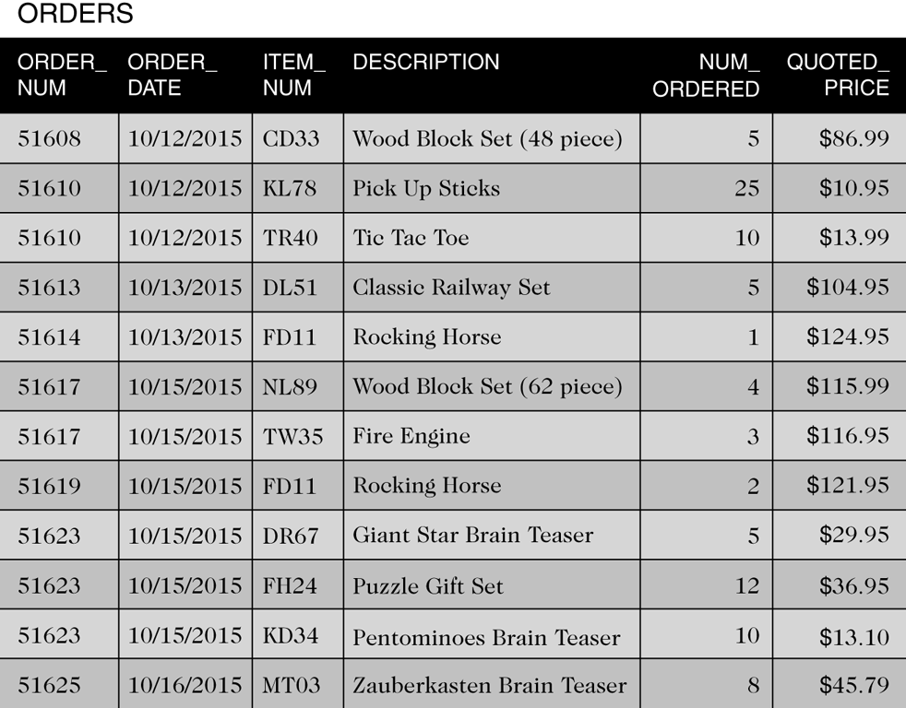
Second Normal Form
Why is this table not in 2NF?
What information is repeating (redundant)?
If ORDER_NUM is the primary key, what information does not depend on the primary key?
Table is in First Normal Form but not in Second Normal Form

Slide 19
Second Normal Form
A relation is in second normal form (2NF) if it is in 1NF and no nonkey attribute is dependent on only a portion of the primary key
or …
All nonkey attributes are functionally dependent on the entire primary key
A 1NF relation with a primary key that is a single field is in 2NF automatically

Slide 20
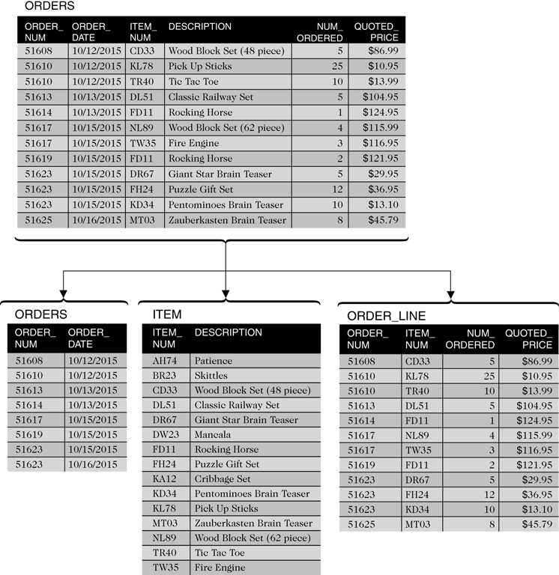
Second Normal Form
What columns are the primary keys in the 2NF tables below?
Figure 2-10 ORDERS table converted to second normal form

Slide 21
Third Normal Form
Update anomalies still possible
Determinant
An attribute (or collection) that functionally determines another attribute

Slide 22
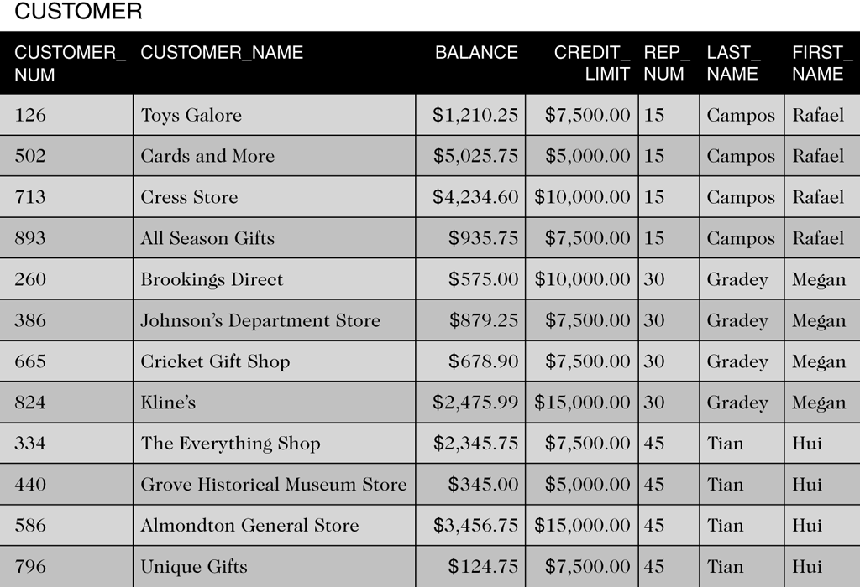
Third Normal Form
Which attribute(s) determine another attribute(s)?
Table is in Second Normal Form but not in Third Normal Form

Slide 23
Third Normal Form
A relation is in third normal form (3NF) if it is in 2NF and the only determinants it contains are candidate keys
Boyce-Codd normal form (BCNF) is the true name for this version of 3NF

Slide 24
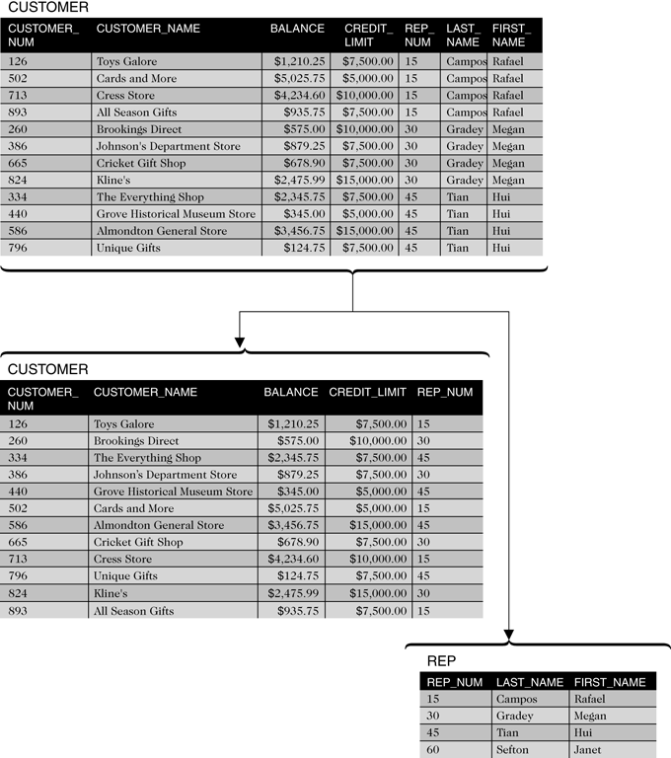
Third Normal Form
Figure 2-12 CUSTOMER table converted to third normal form

Slide 25
Diagrams for Database Design
Graphical illustration
Entity-relationship (E-R) diagram
Rectangles represent entities
Arrows represent relationships

Slide 26
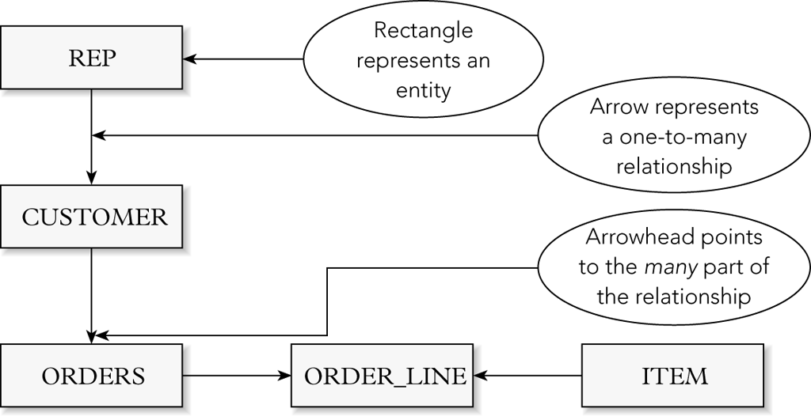
Diagrams for Database Design
Figure 2-13 E-R diagram for the TAL Distributors database with rectangles and arrows

Slide 27
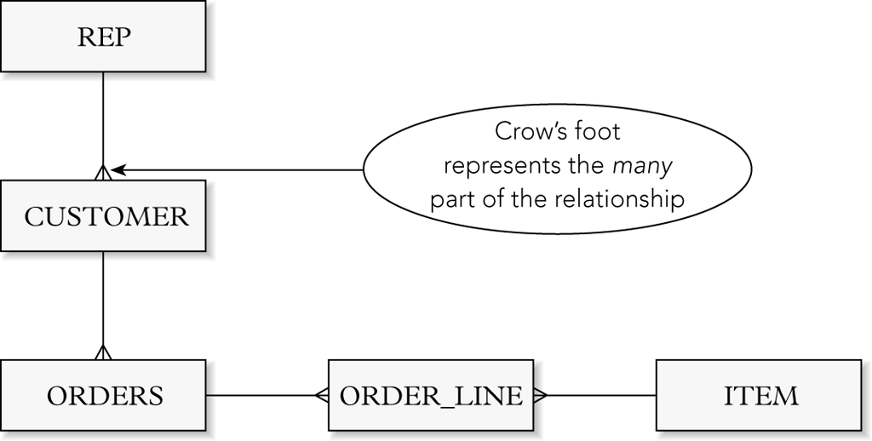
Diagrams for Database Design
Figure 2-14 E-R diagram for the TAL Distributors database with a crow’s foot

Slide 28
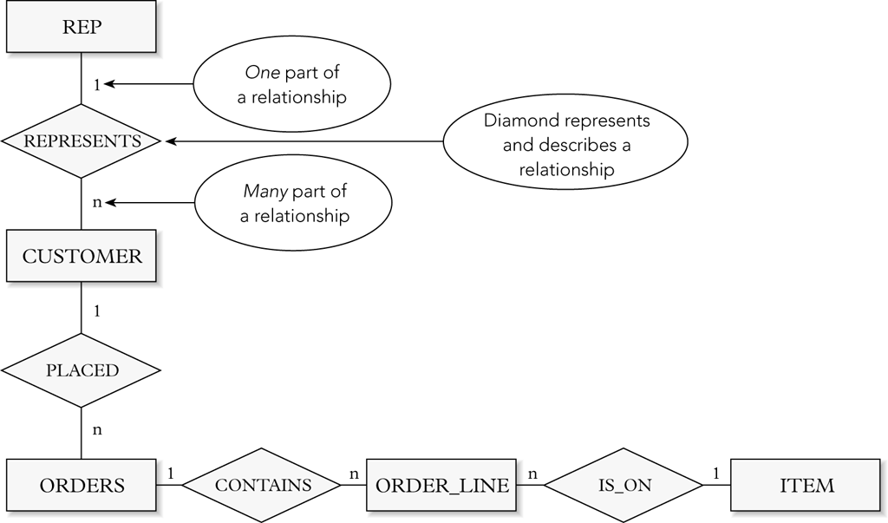
Diagrams for Database Design
Figure 2-15 E-R diagram for the TAL Distributors database with named relationships

Slide 29
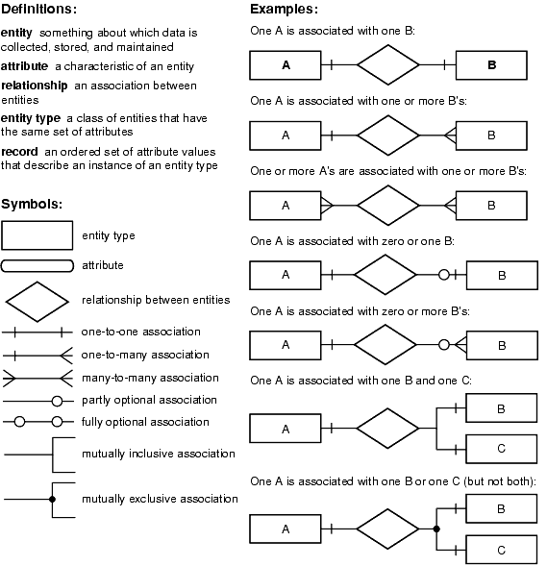
Rules for Drawing an E-R Diagram
https://docs.oracle.com/cd/A87860_01/doc/java.817/a81358/05_dev1.htm

Slide 30
Summary
Definition of entity
Definition of attribute
Definition of relationship
Definition of relation
Definition of functional dependence
Definition of primary key
Database design method

Slide 31
Summary
Normalization
Unnormalized (repeating groups)
First normal form (INF)
Second normal form (2NF)
Third normal form (3NF)
Entity-relationship diagram (E-R diagram)

Slide 32
Exercise
Colonial Adventure Tours is considering offering outdoor adventure classes to prepare people to participate in hiking, biking and paddling adventures. Only one class is taught on any given day. Participants can enroll in one or more classes. Classes are taught by the guides that colonial Adventure employs. Participants do not know who the instructor for a particular class will be until the day of the class. Colonial Adventure Tours needs your help with the database design for this new venture. In each step, represent your answer using the shorthand representation and a diagram.
For each participant, list his or her number, last name, first name, address, city, state, postal code, telephone number and date of birth.
For each adventure class, list the class number, class description, maximum number of people in the class, and class fee.
For each participant, list his or her number, last name, first name and the class number, class description, and date of the class for each class in which the participant is enrolled.
For each class, list the class date, class number and class description; and the number, last name and first name of each participant in the class.

Slide 33
Exercise (continued)
Consider working in groups
Present your solution to the class

